Slide 1
TABLE CALCULATIONS
Copyright (C) 2014 StratApps, Inc. All rights reserved

Slide 2
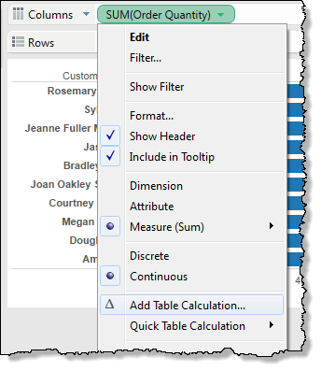
Table Calculations are computations that are applied to the values in the entire table and are often dependent on the table structure itself. For example, in a sales environment, you can use table calculations to compute the running total of sales across a specified date range or to compute each product’s contribution to the total sales in a quarter.
1. Open the Table Calculation Dialog Box
Right-click a measure in the view (control-click on a Mac) and select Add Table Calculation.

Slide 3
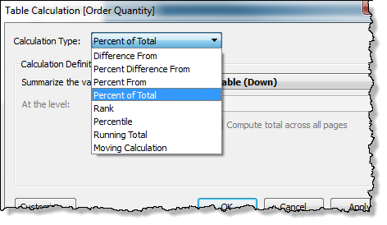
2. Choose a Calculation Type
In the Table Calculation dialog box, choose the type of calculation you want to apply.

Slide 4
Continues..
• Difference From - show absolute change.
• Percent Difference From - show rate of change.
• Percent From - show as % of other specified value.
• Percent of Total - show values as % of the total.
• Rank - rank values numerically
• Percentile - compute percentile values
• Running Total - show a cumulative total.
• Moving Calculation - smooth short fluctuations to identify long term trends.

Slide 5
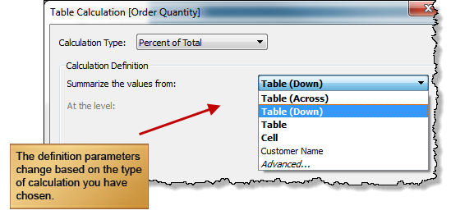
3. Define the Calculation
In the bottom half of the Table Calculation dialog box, define the calculation using the drop-down lists. The options vary for different types of calculations.

Slide 6

4. See the Calculation in Tableau
When you are finished defining the calculation, click OK. The original measure is now marked as a table calculation.
The "Quick" Alternative: Using Quick Table Calculations
Tableau offers common table calculations that you can apply to your view quickly without having to go through the steps for defining the calculation. Right-click a measure in the view, choose Quick Table Calculation, and select one of the available calculation types.

Slide 7
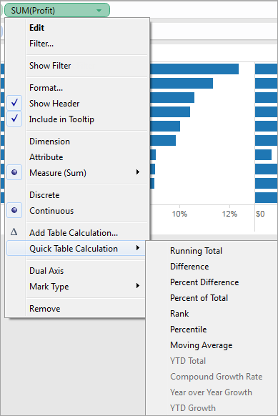
Continues..

Slide 8
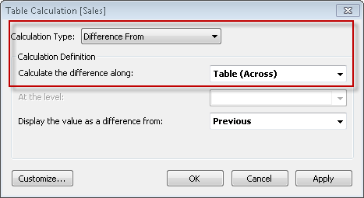
Understanding Table Calculations:
Table calculations are computations that are applied to the values in the table. These computations are unique in that they use data from multiple rows in the database to calculate a value. To create a table calculation, you need to define both what values you want to compute and what values to compute along. These are defined in the Table Calculation dialog box using the Calculation Type and Calculate Along drop-down menus.

Slide 9
The definition of what to compute along has two parts: addressing fields and partitioning fields.
Addressing and Partitioning:
Table calculations are performed on a single measure in the view. The dimensions that define the part of the table you are applying the calculation to (computing along) are called addressing fields, and the dimensions that define how to group the calculation are called partitioning fields. In the example of a running sum of product sales across several years, the addressing field is the Date field, and the partitioning field is the product field. When you define the addressing for a table calculation, all the other dimensions are used for partitioning.
You specify addressing when you create or edit a table calculation, in the Table Calculation dialog box. To update addressing for a field in the view that already has a table calculation, right-click the field and choosing one of the options under Compute using. For example:

Slide 10
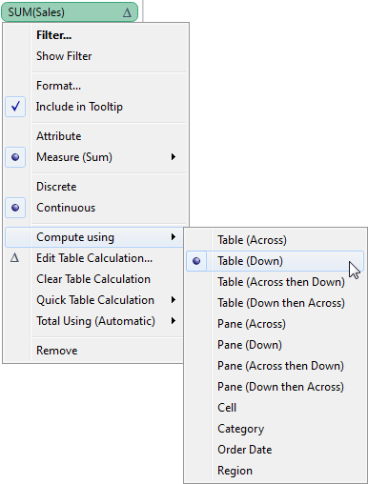
Continues..
Addressing can be relative to the table structure (options beginning with Table, Pane, or Cell) or to a specific field (such as Category, Order Date, orRegion). Addressing options based on table structure are described below.

Slide 11
Table (Across) :
This option sets the addressing to compute along the entire table moving horizontally through each partition. For example, the view below shows quarterly sales by region and product category. When a calculation addressing is set to Table (Across), the dimensions that span horizontally across the table are the addressing fields (in the view below, Category and Region). All the other dimensions (Year, Quarter) are partitioning. The addressing dimensions are shown in orange, while partitioning dimensions are shown in blue.

Slide 12
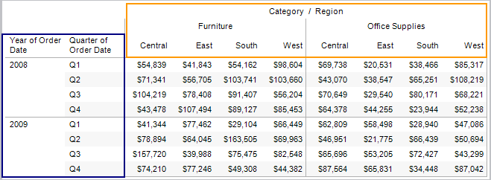
Continues..
That means that each partition will be the combination of Year and Quarter. Any calculation that is performed is scoped to the partition. For example, if the calculation is percent of total, the calculation will be performed on the numbers within each of the orange boxes.

Slide 13
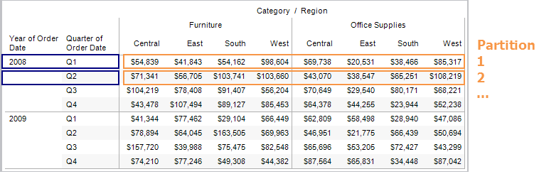
Continues..

Slide 14
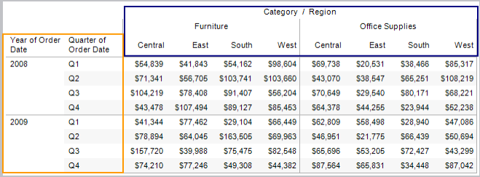
Table (Down):
This option sets the addressing to compute along the entire table moving vertically through each partition. For example, the view from above is shown below with the addressing set to compute along Table (Down). The fields that span vertically (Year, Quarter) are now the addressing fields and the rest of the fields are partitioning (Category, Region). The addressing fields are shown in orange while partitioning fields are shown in blue.

Slide 15
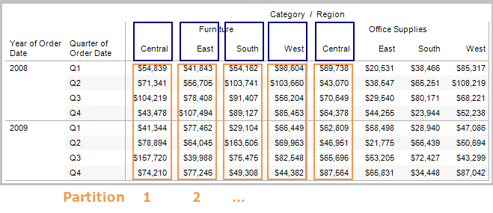
Continues..
That means that each partition is the combination of Category and Region.

Slide 16
Continues..

Slide 17
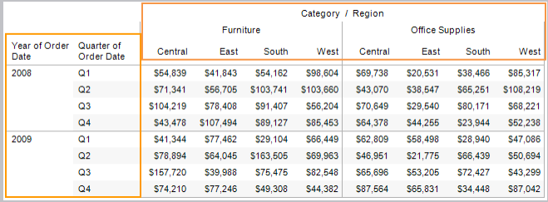
Table (Across then Down)
This option sets the addressing to compute across the entire table horizontally and then down the table vertically. This means that both the fields that span across the table and down the table are addressing fields.

Slide 18
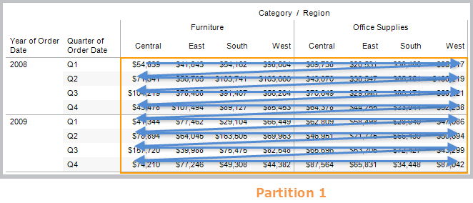
Continues..
That means that the entire table is the partition. The computation will compute across, move to the next row and continue to compute across, and so on.

Slide 19
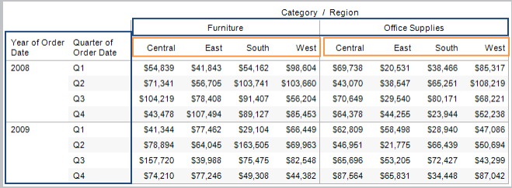
Pane (Across)
This option sets to compute across the pane horizontally. The fields that span across the pane horizontally are the addressing fields. However, the fields that separate the panes are now partitioning fields. In the example below Category becomes a partitioning field along with Year and Quarter. Region is the addressing field.
That means that the combination of Year, Quarter, and Category is the partition.

Slide 20
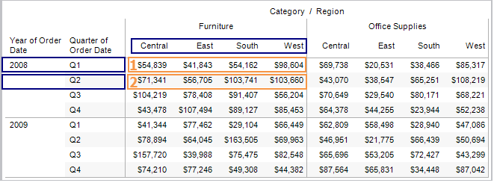
Continues..
Continues..

Slide 21
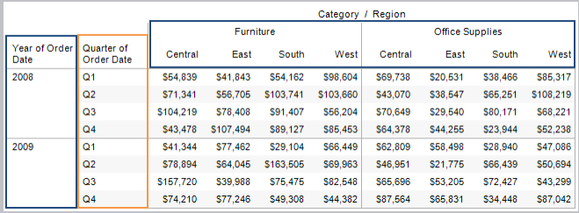
Pane (Down)
This option sets the addressing to compute down the table within the pane. The fields that separate the pane (Category, Year) are partitioning fields. In addition, Region becomes a partitioning field and Quarter is the addressing field.
That means that the combination of Year, Category, and Region is the partition.

Slide 22
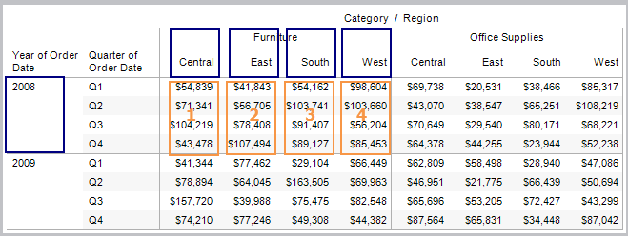
Continues..

Slide 23
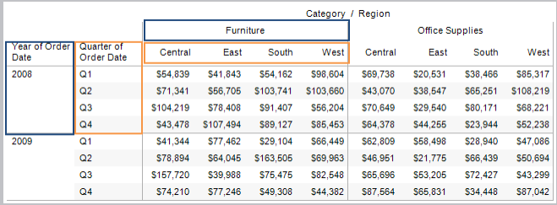
Pane (Across then Down)
This option sets the addressing to compute across within the pane, then move to the next row and continue to compute across. The addressing fields are both the fields that run across the table horizontally and down the table vertically (Region, Quarter). The partitioning fields are the fields that define the pane (Category, Year).

Slide 24
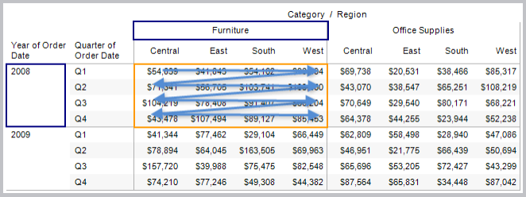
Continues..
That means that the combination of Category and Year make up the partition.

Slide 25
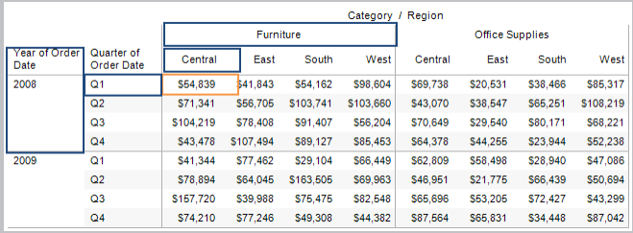
Cell
This option sets the addressing to the individual cells in the table. All fields become partitioning fields. This option is generally most useful when computing a percent of total calculation.

Slide 26
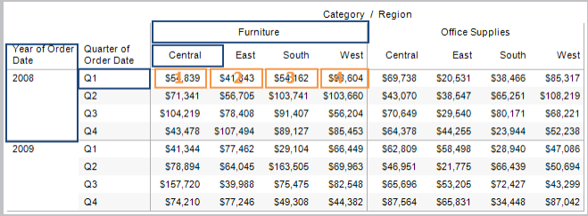
Continues..
That means that the partition is the combination of Category, Region, Year, and Quarter.

Slide 27
Individual Fields
The individual dimensions in the view are listed below the option above in the Table Calculation dialog box. Use them to set the addressing to compute using the field you specify. The benefit of this option is that you get absolute control over how the calculation will be computed—if you change the orientation of your view, the table calculation will continue using the same fields for addressing and partitioning. Be careful though, because, addressing on an individual field means that when you rearrange the table, the calculation may no longer match the table structure.
Advanced
The advanced option lets you specify multiple fields to act as the addressing fields. When you select Advanced, a dialog box opens where you can specify one or more fields to act as addressing fields. Then you can specify how to order those fields.

Slide 28
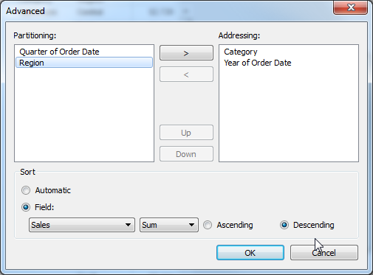
Continues..
For example, in the view below the addressing fields are set to Category and Year. These are ordered by SUM(Sales), in descending order (from greatest to least). That means that the combination of Quarter and Region create the partition. Q1 Central exists four times in the table, and that is the partition.

Slide 29
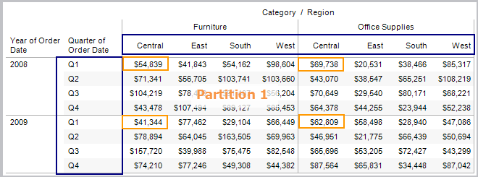
Continues..
Continues..
Because the order is set to SUM(Sales), the calculation is computed based on their SUM(Sales) values from highest to lowest.

Slide 30
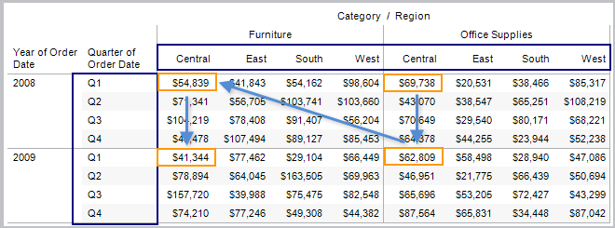
Continues..

Slide 31
Quick Table Calculations
You can add common table calculations to your view using the Quick Table Calculations menu item on the field context menus. These quick calculations are predefined table calculations based on the most common scenarios.
To add a quick table calculation:
1. Right-click (Control-click on a Mac) the measure you want to use in the table
calculation and select Quick Table Calculation.
2. On the sub-menu select one of the following options:
Running Total
Difference
Percent Difference
Percent of Total
Rank

Slide 32
Continues..
Percentile
Moving Average
Year to Date (YTD) Total
Compound Growth Rate
Year over Year Growth
Year to Date (YTD) Growth
After adding a quick table calculation to the view, you can edit its definition by selecting Edit Table Calculation from the field’s context menu.

Slide 33
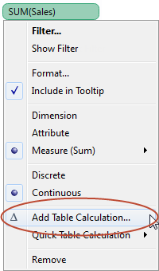
Defining Basic Table Calculations
When you add a Table Calculation to the view, you need to specify the parameters that define the formula used in the computation. All of these parameters are set in the Table Calculation dialog box.
To manually define a table calculation:
1. Right-click (Control-click on a Mac) the measure you want to use in the computation
and choose Add Table Calculation.

Slide 34
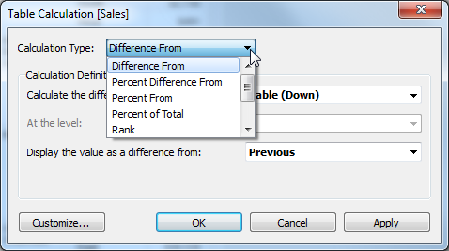
Continues..
2. In the Table Calculation dialog box, select one of the types of calculations from the
drop-down menu at the top.
Define the formula using the drop-down lists further down in the dialog box. Learn more about how to define each type of calculation by selecting it from the Calculation Type field.

Slide 35
Continues..
When finished, click OK. The measure is now marked as a table calculation (the triangle symbol) and all the relevant values in the view are computed using the table calculation.
Secondary Table Calculations:
Table calculations can be very useful when you want to perform a calculation that applies to all of the data in the table. Most of the time you will only need to add a single calculation. However, you may sometimes want to combine two calculations so that you perform one and then perform the next on the results. For example, when calculating the Year to Date Growth, you first need to calculate the cumulative totals and then calculate the percent difference each total is from the previous year.

Slide 36
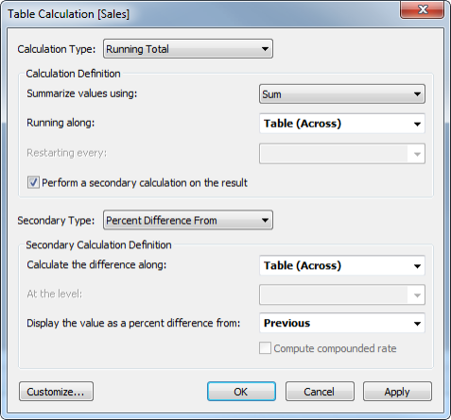
Continues..
You can add a secondary calculation when the Calculation Type is Running Total or Moving Calculation. Select Perform secondary calculation on the result in the Table Calculation dialog box.

Slide 37
Customizing Table Calculations
Table calculations are a special type of calculated field that computes on the local data in Tableau. While you can use the built-in table calculations such as Percent of Total, Difference From, Running Total, and so on; the functions required to define these calculations are also available for use in your own custom calculated fields. Customizing table calculations allows you to compute values such as the difference in number of orders this quarter versus an average quarter, total sales for regions that have above average margin, time since first click on a website, average temperature based on the last three days weighted at 10%, 40%, and 50%, and so much more.
To customize a field in the view to which you have added a table calculation, follow these steps:
1. Open the calculation editor by clicking the drop down to the right of Dimensions on
the Data pane and choosing Create Calculated Field.
2. Double-click the field in the view to which you have added a table calculation. This
opens the field as an ad-hoc calculation.

Slide 38
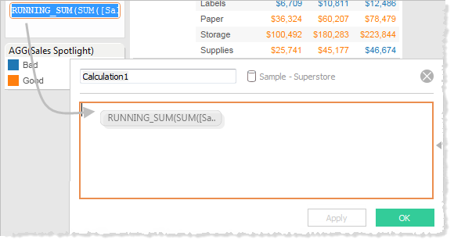
Continues..
3. Select the entire contents of the ad-hoc calculation and then drag it to the calculation
editor:

Slide 39
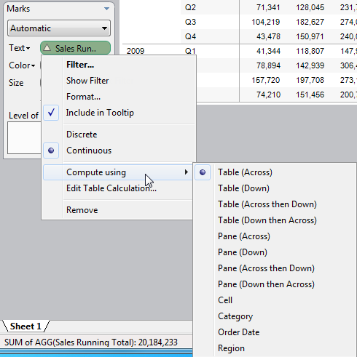
Continues..
To change the addressing for a field with a table calculation, right-click the field and select an option from the Compute Using context menu.

Slide 40
QUERIES?

